Slide 1

Personalized Treatment for Relapsed Ovarian Cancer- What Is the Evidence?
Jonathan Ledermann, MD, FRCP
UCL Cancer Institute
University College London
London, United Kingdom

Slide 2
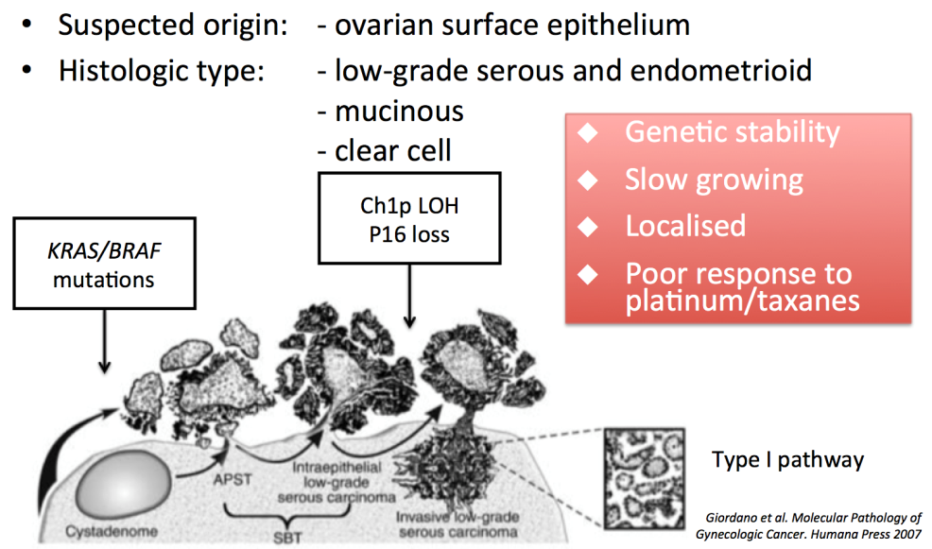

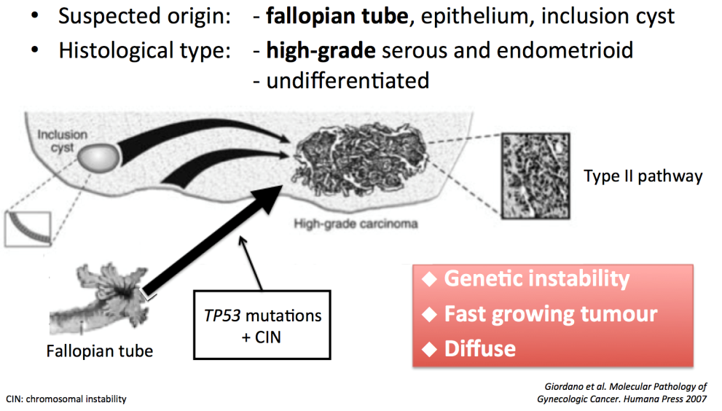
Ovarian Cancer Not One Disease
8704 patients from 7 randomized trials
1.0
0.9
0.8
0.7
0.6
0.5
0.4
0.3
0.2
0.1
0.0
Histology
Serous Adenoca
Mucinous
Clear Cell
Transitional
0 12 24 36 48 60 72 84 96
Months on Study
Mackay HJ, et al. Int J Gynecol Cancer. 2010;20(6):945-952.
But we still give all patients the same treatment!

Slide 3

Survival of Patients With Ovarian Cancer and BRCA Mutations
1.00
0.75
0.50
0.25
0.00
Noncarriers
BRCA1
BRCA2
0 2 4 6 8 10
1924 2914 2295 1657 1120 812
404 676 499 323 198 118
162 278 239 152 86
Number at risk
Noncarriers
Carriers
BRCA1
BRCA2
Years From Diagnosis
Candido Dos Reis FJ, et al. Clin Cancer Res. 2014 Nov 14. [Epub ahead of print].

Slide 4
Examples of Predictive Cancer Biomarkers in Solid Tumors
Tumor Type | Biomarker
Breast | ER; HER2/neu
Colorectal | EGFR; KRAS; UGT1A1
Gastric | HER2/neu
GIST | c-KIT
GBM | EGFR; PDGFRα
Lung | ALK; EGFR; KRAS; ROS1; PDL1
Medullary thyroid | RET
Melanoma | BRAF; PDL1
EGFR, epidermal growth factor receptor; ER, estrogen receptor; GBM, glioblastoma; GIST, gastrointestinal stromal tumor; PDGFRα, platelet-derived growth factor receptor alpha; PDL1, programmed death ligand 1

Slide 5
The Cancer Genome Atlas (TCGA) Project
High-Grade Serous Ovarian Carcinoma
TP53 mutations present in 96%
Significant occurrence of mutation in 9 other genes but prevalence low
  Including: NF1; BRCA1; BRCA2; RB1; CDK12
Huge genomic disarray: Very high number of structural chromosomal abnormalities. Significant focal DNA copy number aberrations and promoter methylations events
Genes involved in homologous recombination are frequently affected → suggests high sensitivity to PARP inhibitors
The Cancer Genome Atlas Research Network. Nature. 2011;474(7353):609-615.

Slide 6
The HR Phenotype and the Potential of PARP Inhibitors in Sporadic Ovarian Cancer
BRCA1
BRCA2
germline
germline
8%
6%
BRCA1
somatic
BRCA2
3%
somatic
Other
34%
3%
BRCA1
methylation
11%
EMSY
MMR
amplification
germline
6%
2%
PTEN loss
CCNE1
5%
amplification 15%
Other HRD
7%
Not HR deficient
Homologous recombination
(HR) deficient
Levine D. 2011. The Cancer Genome Atlas, Molecular Profiling of Serous Ovarian Cancer. Data retrieved from cBio Cancer Genomics Portal http://www.cbioportal.org/public-portal/. Accessed 12 August 2012.

Slide 7
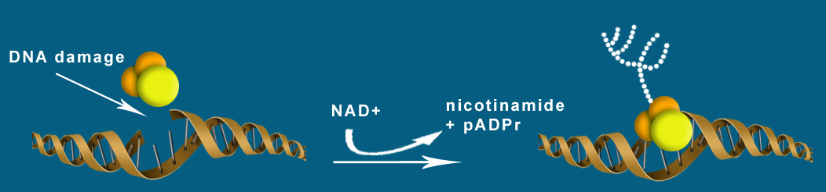
Poly(ADP-Ribose) Polymerase
A key regulator of DNA damage repair processes
Involved in DNA base-excision repair (BER)
Binds directly to DNA damage
Produces large branched chains of poly(ADP-ribose)
Attracts and assists BER repair effectors
PARP
DNA repair
proteins
PARP

Slide 8
PARP Inhibition and Tumor-Selective Synthetic Lethality
γH2AX
SSB
PARP
inhibitor
DSB
DNA replication fork arrest and collapse
Normal HR repair
Impaired HR repair
RAD51
Alternative error-prone repair mechanism
HR-based repair
Chromosome stability
Cell survival
Chromosomal instability
Cell death
Slide provided with permission by Andrew Tutt
DSB, double-strand break; HR, homologous recombination;
SSB, single-strand break
Farmer H, et al. Nature. 2005;434(7035):917-921.
Bryant HE, et al. Nature. 2005;434(7035):913-917.

Slide 9
Phase I and II Studies With Olaparib, an Orally Active PARP Inhibitor
 | Olaparib Phase I and BRCA Mutation Expansion Studies^{1,2} | Olaparib Phase II BRCA | Olaparib Phase II BRCA
Olaparib dose | 200 mg bid | 400 mg bid | 100 mg bid
RECIST CR/PR | 14/50 (28%) | 11/33 ( 33%) | 3/24 ( 13%)
SD | 3/50 (6%) (≥4 months) | 12/33 ( 36%) (8 weeks) | 14/24 (58%) (8 weeks)
Median duration of response | ~214 d | 290 d | 269 d
1. Fong PC, et al. N Engl J Med 2009;361(2):123-134. 2. Fong PC, et al. J Clin Oncol. 2010;28(15):2512-2519 3. Audeh MW, et al. Lancet 2010;376(9737):245-251.

Slide 10
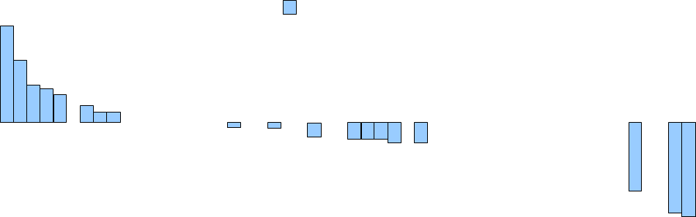

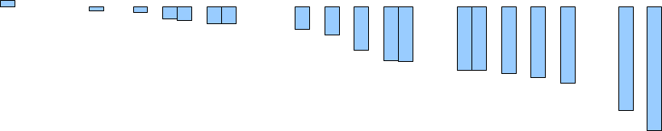


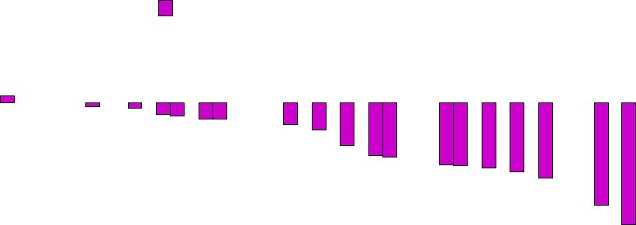
Olaparib in BRCA and
Non-BRCA Ovarian Cancer
120
100
80
60
40
20
0
–20
–40
–60
–80
–100
Ovarian BRCA
Ovarian non-BRCA
Best Change From Baseline in Size of Target Lesion, %
BRCA, platinum resistant or refractory
BRCA, platinum sensitive
Non-BRCA, platinum resistant or refractory
Non-BRCA, platinum sensitive
120
100
80
60
40
20
0
–20
–40
–60
–80
–100
Best Change From Baseline in Size of Target Lesion, %
Gelmon KA, et al. Lancet Oncol. 2011;12(9):852-861.

Slide 11
Treatment Pathway for Recurrent Ovarian Cancer
End of therapy for relapse
Restart chemotherapy for clinical progression
Placebo
PARP inhibitor (olaparib)
Restart chemotherapy
Randomized Maintenance Trials

Slide 12
Randomized Trial of Maintenance Olaparib in Platinum-Sensitive High Grade Serous Relapsed Ovarian Cancer - ‘Study 19’
Study aim and design
265 patients
Patients:
Platinum-sensitive high-grade serous ovarian cancer
≥2 previous platinum regimens
Last chemotherapy was platinum-based to which they had a maintained PR or CR prior to enrolment
Stable CA-125
Olaparib
400 mg PO bid
Treatment until
disease
progression
Randomized 1:1
Placebo
PO bid
Sept 2008- Feb 2010
16 countries; 82 sites
Primary endpoint :
Progression-free survival (PFS)
Ledermann J, et al. N Engl J Med. 2012;366(15):1382-1392.

Slide 13
Progression-Free Survival
1.0
Olaparib
60:136 (44.1)
8.4
Placebo
93:129 (72.1)
4.8
0.9
No. of events: Total patients (%)
Median PFS, months
0.8
0.7
Hazard ratio 0.35 (95% CI, 0.25-0.49);
P<.00001
0.6
Proportion of Patients Progression Free
0.5
0.4
0.3
0.2
Randomized treatment
0.1
Placebo
0
Olaparib 400 mg bid
0
3
6
9
12
15
18
At risk (n)
Time From Randomization, Months
Olaparib
136
104
51
23
6
0
0
Placebo
129
72
23
7
1
0
0
Ledermann J, et al. N Engl J Med. 2012;366(15):1382-1392.
Notes:
Data Cut off June 2010

Slide 14
Common Adverse Events*
Olaparib 400 mg bid
(n = 136)
Placebo
(n = 128)
Percentage of Patients
Adverse Event
Any event
Nausea
Fatigue
Vomiting
Diarrhea
Headache
Decreased appetite
Abdominal pain
Anemia
Dyspepsia
Grade 1/2
61
66
42
29
21
18
18
16
12
16
Grade 3/4
35
2
7
2
2
0
0
2
5
0
Grade 1/2
70
35
34
13
20
11
13
23
4
9
Grade 3/4
20
0
3
1
2
1
0
3
1
0
42
29
12
7
2
5
34
13
4
3
1
1
Fatigue
Vomiting
Anemia
*Adverse events graded according to maximum CTCAE version 3.0 grade, experienced by >15% of patients in either treatment group
Ledermann J, et al. N Engl J Med. 2012;366(15):1382-1392. Ledermann JA, et al. J Clin Oncol. 2011;29(suppl);
Abstract 5003.
Notes:
Adverse events with a >10% occurrence in patients receiving olaparib (experienced by >15% of patients in either treatment group) were nausea, fatigue, vomiting and anemia.

Slide 15
Toxicity and Tolerability
Olaparib
400 mg bid
n = 136
Placebo
n = 128
Discontinuations due to AEs, n (%)
Dose interruptions due to AEs, n (%)
Dose reductions due to AEs, n (%)
Median treatment duration, days
3 (2)
41 (30)
26 (19)
207
1 (1)
12 (9)
3 (2)
141
No detrimental impact on HRQoL (Treatment Outcome Index of FACT-0) compared with placebo
- Overall study population and patients with a BRCAm
AE, adverse event; BRCAm, BRCA mutation; HRQoL, health-related quality of life
Ledermann JA, et al. J Clin Oncol. 2011;29(28):3798-3804. Ledermann J, et al. Ann Oncol. 2014;25(suppl 4):
Abstract 885PD.
Notes:
The number of patients presented for dose interruptions, reductions and discontinuations is based on the last action recorded for a given AE
8+8 capsules per day

Slide 16
Overall Survival (OS): Interim Analysis*
Olaparib
52:136 (38.2)
29.7
Placebo
49:129 (38.0)
29.9
1.0
No. of events: Total patients, %
Median OS (months)
0.9
0.8
Hazard ratio 0.94 (95% CI, 0.63-1.39);
P = .748
0.7
0.6
Proportion of Patients Alive
0.5
0.4
0.3
0.2
Randomized treatment
0.1
Placebo
Olaparib 400 mg bid
0
0
3
6
9
12
15
18
21
24
27
30
33
36
At risk, n
Time From Randomization, Months
Olaparib
136 | 132 | 128 | 124 | 117 | 109 | 94 | 79 | 45 | 24 | 4 | 0 | 0
129 | 127 | 120 | 111 | 108 | 96 | 86 | 78 | 44 | 21 | 3 | 1 | 0
Placebo
*Performed at 38% maturity
Ledermann J, et al. N Engl J Med. 2012;366(15):1382-1392.

Slide 17
BRCA Status
Olaparib 400 mg bd
52/136 (38%)
8/31 (26%)
11/18 (61%)
33/87 (38%)
Placebo
49/129 (38%)
12/28 (43%)
5/20 (25%)
32/81 (40%)
Overall
gBRCA positive
gBRCA negative
gBRCA status unknown
0.125
0.25
0.5
1.0
2.0
4.0
8.0
16.0
HR (olaparib:placebo) and 95% CIs
Favors olaparib
Size of circle is proportional to number of events
Purple band represents 95% CI for overall population
BRCAm status was not required for study entry, but was known for 97/265 patients (36.6%)
 | Olaparib (n = 136) | Placebo (n = 129)
BRCA mutation status, n (%)* BRCA1 BRCA2 BRCA1 & BRCA2 Known negative Unknown | 25 (18) 6 (4) 0 18 (13) 87 (64) | 20 (16) 7 (5) 1 (1) 20 (16) 81 (63)
Ledermann J, et al. N Engl J Med. 2012;366(15):1382-1392.

Slide 18
PFS in Patients With a BRCA Mutation*
  136 (51.3%) patients had a known deleterious BRCAm (BRCAm dataset)
  118 (44.5%) patients were defined as BRCA1/2wt for this analysis
  11 (4.2%) patients had neither a tumor nor a germline result available
 | BRCAm (n = 136)
 | Olaparib | Placebo
Events: total patients (%) | 26:74 (35.1) | 46:62 (74.2)
Median PFS, months | 11.2 | 4.3
 | HR = 0.18 95% CI (0.10, 0.31); P<.00001
1.0
0.9
0.8
0.7
0.6
Proportion of Patients Progression Free
0.5
0.4
0.3
0.2
Randomized treatment†
0.1
Olaparib BRCAm
Placebo BRCAm
0
0
3
6
9
12
15
Time From Randomization, Months
Number at Risk
Olaparib BRCAm
74
59
34
15
5
0
Placebo BRCAm
62
35
13
2
0
0
BRCAwt, BRCA wildtype
*Includes patients with germline and/or somatic mutations; †patients were treated until disease progression
Ledermann J, et al. Lancet Oncol. 2014;15(8):852-861.

Slide 19
PFS in BRCAwt Patients
 | BRCAm (n = 118)
 | Olaparib | Placebo
Events: total patients (%) | 32:57 (56.1) | 44:61 (72.1)
Median PFS, months | 5.6 | 5.5
 | HR = 0.54 95% CI (0.34, 0.85); P = .0075
1.0
0.9
0.8
0.7
0.6
Proportion of Patients Progression-Free
0.5
0.4
0.3
0.2
Randomized treatment†
0.1
Olaparib BRCAwt
0
Placebo BRCAwt
0
3
6
9
12
15
Time From Randomization, Months
Number at Risk
Olaparib BRCAwt
57
45
18
9
2
0
Placebo BRCAwt
61
35
10
4
1
0
BRCAwt includes patients with no known BRCAm or a mutation of unknown significance
†Patients were treated until disease progression
Ledermann J, et al. Lancet Oncol. 2014;15(8):852-861.

Slide 20
OS in Patients With a BRCA1/2 Mutation*
An interim OS analysis was performed after 154 deaths (58% maturity)
No statistically significant benefit was observed in the overall population (HR = 0.88, 95% CI, 0.64–1.21, P = .442) or in patients with a BRCAm
 | BRCAm (n = 136)
 | Olaparib | Placebo
Deaths: total patients (%) | 37:74 (50.0) | 34:62 (54.8)
Median OS, months | 34.9 | 31.9
 | HR 0.73 95% CI (0.45, 1.17) P = .192
1.0
0.9
0.8
0.7
0.6
Proportion of Patients Alive
0.5
0.4
0.3
0.2
Randomized treatment†
Olaparib BRCAm
0.1
Placebo BRCAm
0
0
3
6
9
12
15
18
21
24
27
30
33
36
39
42
45
48
Number at Risk
Time From Randomization, Month
Olaparib BRCAm
74
71
69
67
65
62
56
53
50
48
39
36
26
12
7
Placebo BRCAm
62
62
58
52
50
46
39
36
33
29
29
27
21
10
4
*Includes patients with germline and/or somatic mutations; †patients were treated until disease progression
Ledermann J, et al. Lancet Oncol. 2014;15(8):852-861.

Slide 21



Time to Second Subsequent Therapy – A New Exploratory Endpoint
  TSST (time from randomization to second subsequent therapy or death)
  PFS2 (time from randomization to second objective disease progression or death)
Progression
Intermediate clinical endpoints
Olaparib maintenance monotherapy
PFS
PFS2†
TSST
OS
Chemo
Chemo
First subsequent treatment response
Progression
Progression
All patients who received treatment were included in exploratory endpoint analyses
Notes:
Since the analyses of exploratory endpoints assessed the time from randomization to the relevant event, the analyses were performed in the safety analysis set (n=264), which included all patients who received at least one dose of study treatment (rather than just those patients who had received a subsequent chemotherapy).

Slide 22
Time to Second Subsequent Therapy – A New Exploratory Endpoint
  TSST (time from randomization to second subsequent therapy or death)
  PFS2 (time from randomization to second objective disease progression or death)
Progression
Intermediate clinical endpoints
Olaparib maintenance monotherapy
PFS
PFS2†
TSST
OS
Chemo
Chemo
First subsequent treatment response
Progression
Progression
All patients who received treatment were included in exploratory endpoint analyses
Notes:
Since the analyses of exploratory endpoints assessed the time from randomization to the relevant event, the analyses were performed in the safety analysis set (n=264), which included all patients who received at least one dose of study treatment (rather than just those patients who had received a subsequent chemotherapy).

Slide 23
TSST in Patients With a BRCA1/2 Mutation*
1.0
 | BRCAm (n = 136)
 | Olaparib | Placebo
Events: total pts (%) | 42:74 (56.8) | 49:62 (79.0)
Median TSST, months | 23.8 | 15.2
 | HR 0.44 95% CI (0.29, 0.67) P = .00013
0.9
0.8
0.7
0.6
Proportion of Patients not on Second Subsequent Therapy
0.5
0.4
0.3
0.2
Randomized treatment†
0.1
Olaparib BRCAm
0
Placebo BRCAm
0
5
10
15
20
25
30
35
40
45
50
Number at Risk
Time From Randomization, Months
Olaparib BRCAm
74
70
65
50
37
33
30
23
9
0
0
Placebo BRCAm
62
60
45
30
20
17
10
8
1
0
0
*Includes patients with germline and/or somatic mutations; †patients were treated until disease progression
Ledermann J, et al. Lancet Oncol. 2014;15(8):852-861.
Notes:
In both the BRCAm and BRCAwt groups, the TSST data show that the effect of olaparib treatment continues beyond the first progression, leading to a clinically meaningful delay in the onset of the second subsequent therapy.

Slide 24



Overview of Efficacy Analyses in Patients With a BRCA1/2 Mutation
4.3
6.9-month difference
Primary endpoint
PFS
11.2
HR: 0.18 (95% CI 0.10, 0.31), P<.00001
TFST (Exploratory)
6.2
9.4-month difference
15.6
HR: 0.33 (95% CI 0.22, 0.50), nominal P<.00001
Placebo
Olaparib 400 mg bid
TSST (Exploratory)
15.2
8.6-month difference
23.8
HR: 0.44 (95% CI 0.29, 0.67), nominal P = .00013
31.9
3.0-month difference
OS
34.9
HR: 0.73 (95% CI 0.45, 1.71), P = .192
0
5
10
15
20
25
30
35
Month
Chemo
Maintenance treatment
Chemo
Chemo
First subsequent treatment response
Ledermann J, et al. Lancet Oncol. 2014;15(8):852-861.

Slide 25
SOLO-1 & SOLO 2 Program
BRCAm Population Only
First-line maintenance or maintenance in ‘platinum-sensitive’ setting
Olaparib tablet 300 mg bd
SOLO-1 344 patients
2 years
PFS/PFS2/OS + QoL
Olaparib
Response to platinum-based chemotherapy
Randomization
2:1
SOLO-2 264 patients
to progression
PFS/PFS2/OS + QoL
Placebo

Slide 26
NOVA and ARIEL3 Program
Both studies include a BRCAm and high-grade serous wildtype subsets
Niraparib
360 patients
2 cohorts - BRCAm & BRCAwt
PARPi
Platinum-sensitive ovarian cancer responding to platinum-based therapy
Randomization
2:1
Rucaparib
540 patients
2 cohorts – BRCAm & BRCAwt
Placebo
Identification of companion diagnostic marker to select patients with HRD, most likely to benefit
HRD, homologous recombination deficiency

Slide 27
Maintenance PARP Inhibitor Therapy
PARP inhibitor maintenance therapy
  Marked effect on delaying progression of patients with ‘platinum-sensitive’ disease, especially in BRCAm population
  Significant but lesser effect in BRCAwt patients with high-grade serous cancer
Prolonged exposure does not impair QoL; well tolerated by most patients
Ongoing trials of 3 different PARP inhibitors as maintenance therapy for ovarian cancer

Slide 28
Olaparib
Now licensed by the European Medicines Agency (EMA) for maintenance therapy of relapsed high grade serous ovarian/ tubal/peritoneal cancer after a response to platinum-based chemotherapy in BRCA-mutated ovarian cancer
First target specific therapy in ovarian cancer
Testing for a BRCA mutation in all patients is now essential. Mutations are seen in ~20% of high-grade serous disease and a significant number of BRCAm-positive patients do not have a family history of breast/ovarian cancer

